Slide 1
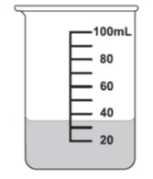

Measurement Interactive Notebook
Name
Class
Teacher
Term 3 Semester 2
1

Slide 2
Create your own front page
It needs to contain the following –
My measurement interactive notebook
Name
Class
Teachers Name: Mrs. Whitehurst
Semester 2 Term 3
Page number 1

Slide 3
Contents
Glossary or Formula Page
Page
Date
Description
2
3

Slide 4
Tasks
24
7
30
Essential Question
Questions
Notes
Summary
4
5

Slide 5
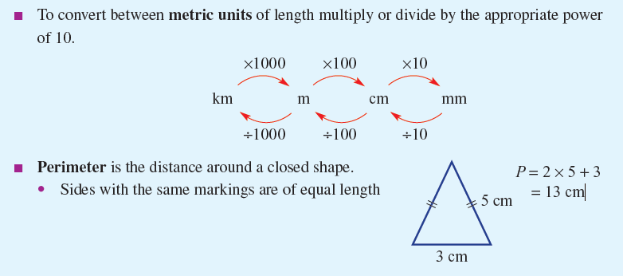
24
7
30
Date
Length
EQ – How do I convert length measurements to determine perimeter?
Why is length important?
How do I convert metric units?
What is the perimeter?
Length is at the foundation of measurement from which the concepts of perimeter, circumference, area and volume are developed.
5

Slide 6
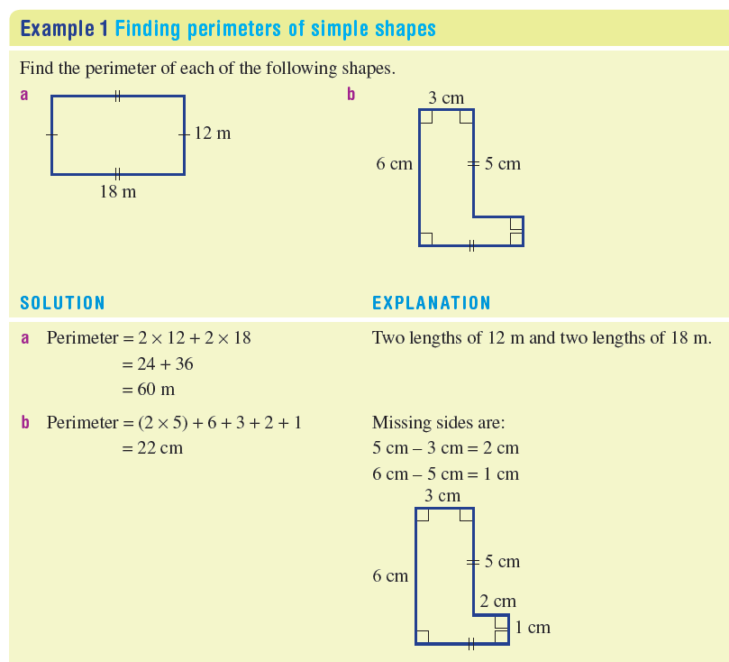
24
7
30
Date
Length
EQ – How do I convert length measurements to determine perimeter?
5

Slide 7
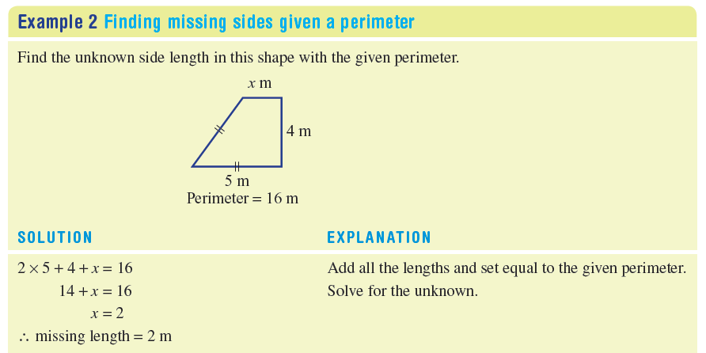
24
7
30
Date
Length
EQ – How do I convert length measurements to determine perimeter?
5

Slide 8
Task
TEXT: Essentials 9
Complete Numbers 1- 6 from pages 267 – 268 in the text book.
Extension/Early Finishers
Complete Numbers 7-8 from page 268 in the text book.

Slide 9
Notes Review
24, 7 ,30
Date
Title
Essential question
Notes complete
Notes complete with colour and diagrams
Questions completed
Contents page filled in
Formula page filled in

Slide 10
Homework
Review your notes and write a summary answering the essential question.

Slide 11
24
7
30
Date
Length
EQ – How do I use measurement conversions and perimeter to solve problems?
Remember:
5

Slide 12
Task
TEXT: Essentials 9
Complete Numbers 9-15 from pages 268 – 269 in the text book.
Extension/Early Finishers
Complete Number 16 from page 269 in the text book.

Slide 13
Notes Review
24, 7 ,30
Date
Title
Essential question
Notes complete
Notes complete with colour and diagrams
Questions completed
Contents page filled in
Formula page filled in

Slide 14
Homework
Review your notes and write a summary answering the essential question.

